Slide 1
THE SCIENCE OF SIN AND SALVATION
Copyright©2010 Robert Melashenko

Slide 2
There was nothing poisonous in the fruit of the tree of knowledge itself, nothing that would cause death in partaking of it. The tree had been placed in the garden to test their loyalty to God. The Lord designs that we shall contemplate the lesson that Adam failed to learn in his first experience, and would have us realize that the claims of God in this age are no less than they were in the Garden of Eden.
{ST, February 13, 1896 par. 6}

Slide 3
In order to possess an endless existence, man must continue to partake of the tree of life. Deprived of this, his vitality would gradually diminish until life should become extinct. It was Satan's plan that Adam and Eve should by disobedience incur God's displeasure; and then, if they failed to obtain forgiveness, he hoped that they would eat of the tree of life, and thus perpetuate an existence of sin and misery. But after man's fall, holy angels were immediately commissioned to guard the tree of life. Around these angels flashed beams of light having the appearance of a glittering sword. None of the family of Adam were permitted to pass the barrier to partake of the life-giving fruit; hence there is not an immortal sinner. {PP 60}

Slide 4
It was not the will of God that the sinless pair should know aught of evil. He had freely given them the good, and had withheld the evil. But, contrary to His command, they had eaten of the forbidden tree, and now they would continue to eat of it--they would have the knowledge of evil--all the days of their life. From that time the race would be afflicted by Satan's temptations. Instead of the happy labor heretofore appointed them, anxiety and toil were to be their lot. They would be subject to disappointment, grief, and pain, and finally to death. Under the curse of sin all nature was to witness to man of the character and results of rebellion against God. When God made man He made him rule over the earth and all living creatures. So long as Adam remained loyal to Heaven, all nature was in subjection to him. But when he rebelled against the divine law, the inferior creatures were in rebellion against his rule.
Thus the Lord, in His great mercy, would show men the sacredness of His law, and lead them, by their own experience, to see the danger of setting it aside, even in the slightest degree. {PP 59}

Slide 5
Hypothesis #1; The Adversary is the “engineer” of TE’s and viruses:
“Hallmark Genes” code for remarkably complex proteins when compared to those found in humans. There are no real human analogues. ( RT gene).
Viruses must elude approximately 50 body defenses to infect human cells….it takes incredible engineering to make this happen.
This complex “entity” would have had to evolve on a completely separate pathway at precisely the same time as life was first “evolving” on an altogether different evolutionary path. This is statistically unlikely.

Slide 6
Hypothesis #2; TE’s are the source of the inherited “tendencies” to transgress God’s Law:
TE’s can markedly affect behavior (mountain and prairie voles).
TE’s are not randomly spread throughout the human genome. They cluster around the genes that code for proteins used in the central nervous system (CNS).
The “Y” and “X” chromosomes have the largest percentage of TE’s.

Slide 7
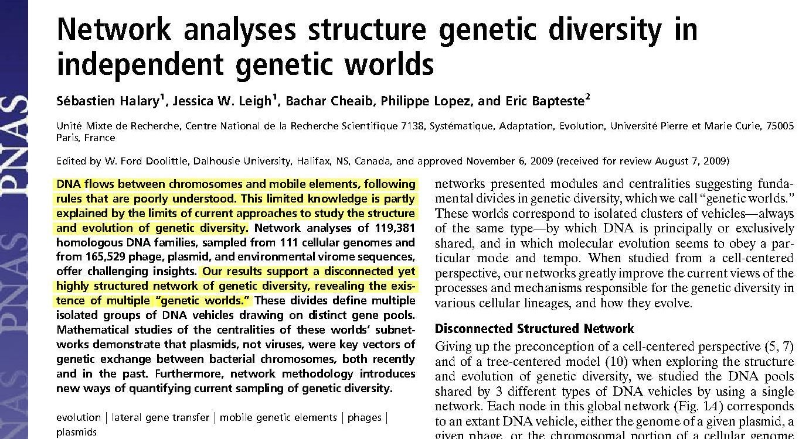
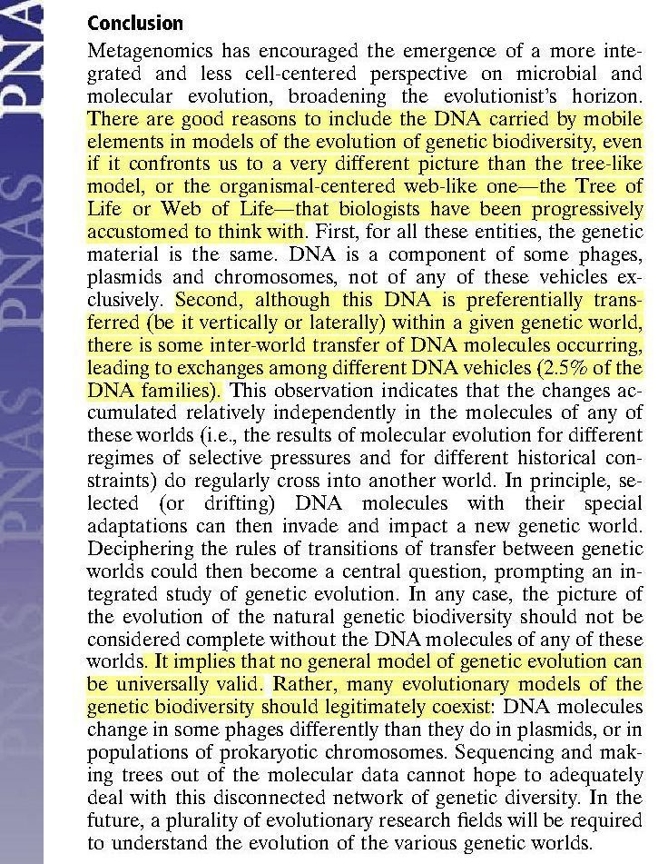

Slide 8
Hypothesis #3; TE’s introduced death to all organisms on earth:
"The wages of sin is death; but the gift of God is eternal life through Jesus Christ our Lord." [ROM. 6:23.] While life is the inheritance of the righteous, death is the portion of the wicked. Moses declared to Israel, "I have set before thee this day life and good, and death and evil." [DEUT. 30:15.] The death referred to in these scriptures is not that pronounced upon Adam, for all mankind suffer the penalty of his transgression. It is the "second death" that is placed in contrast with everlasting life. {GC88 544.1}

Slide 9
“…….HOW IS IT CORRECTED?”
God’s entire creation has been “hijacked”.
Adam and Eve, along with every other living creature, have been reprogrammed to be at odds with Him.
The Adversary and his angels are alive and boasting that to transgress God’s law does not result in death…..just look at them for proof!
If Adam and Eve are allowed to reap the consequence of their choice and die, the Adversary will claim that God destroyed them to stop the rebellion….if God supports them and keeps them from dying, then God will appear to be lying about the consequences of sin (“……for in the day that thou eatest thereof thou shalt surely die”) Genesis 3:17 KJV

Slide 10
God appears trapped. What, if anything, can be done to reclaim His earthly creation and vindicate His name in front of the whole universe?
If the “wages of sin is death”, and Adam and Eve sinned by eating of the fruit in the Garden of Eden, why didn’t they die the “second” death right then and there? Or put another way; Why isn’t the “second “ death the “first and only” death?

Slide 11
First, God must deal with Adam and Eve’s “new fallen” nature.
“And the LORD God said unto the serpent, Because thou hast done this, thou [art] cursed above all cattle, and above every beast of the field; upon thy belly shalt thou go, and dust shalt thou eat all the days of thy life:
And I will put enmity between thee and the woman, and between thy seed and her seed; it shall bruise thy head, and thou shalt bruise his heel.” Genesis 3:14, 15 KJV

Slide 12
What did God mean by the term “put enmity” between the Devil’s “seed” and the woman’s “seed”?
Seed = zera‛
BDB Definition:
1) seed, sowing, offspring
1a) a sowing
1b) seed
1c) semen virile
1d) offspring, descendants, posterity, children
1e) of moral quality
1e1) a practitioner of righteousness (figuratively)
1f) sowing time (by metonymy)
Part of Speech: noun masculine

Slide 13
G4690 - Strong’s Number - Greek
sperma H319 acharit - after part, end
sperma H1121 ben - son, grandson, child
sperma H1320 basar - flesh
sperma H2233 zera - seed, sowing, semen virile
sperma H5209 nin - offspring, posterity
sperma H5220 nekhed - progeny, posterity

Slide 14
σπέρμα sperma
Thayer Definition:
1) from which a plant germinates
1a) the seed, i.e. the grain or kernel which contains within itself the germ of the future plants
1a1) of the grains or kernels sown
1b) metaphorically a seed, i.e. a residue, or a few survivors reserved as the germ of the next generation (just as seed is kept from the harvest for the sowing)
2) the semen virile
2a) the product of this semen, seed, children, offspring, progeny
2b) family, tribe, posterity
2c) whatever possesses vital force or life giving power
2c1) of divine energy of the Holy Spirit operating within the soul by which we are regenerated
Part of Speech: noun neuter

Slide 15
Historical view of Genesis 3:15:
You and this woman will hate each other; your descendants and hers will always be enemies. One of hers will strike you on the head, and you will strike him on the heel." Genesis 3:15 CEV
The Adversary does not have any “descendants”, all of the “descendants” come from the woman and Adam (who is not even mentioned here…why?).
Genomic view:
And I will put enmity between thee and the woman, and between thy seed (Genetic Material) and her seed (Genetic Material); it shall bruise thy head, and thou shalt bruise his heel. Gen 3:15 KJV

Slide 16
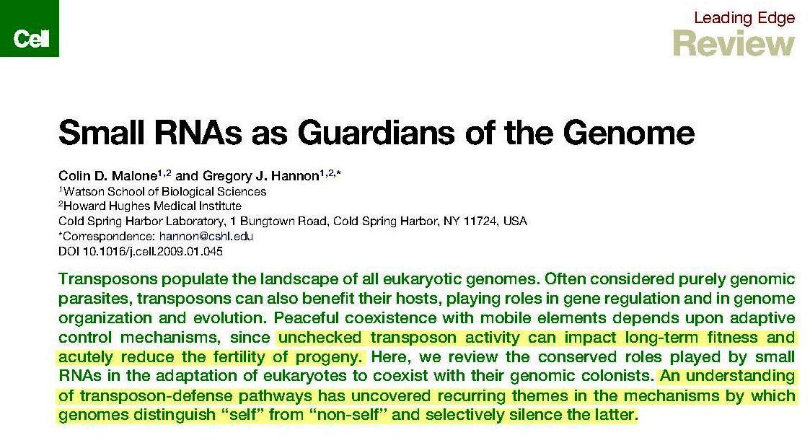
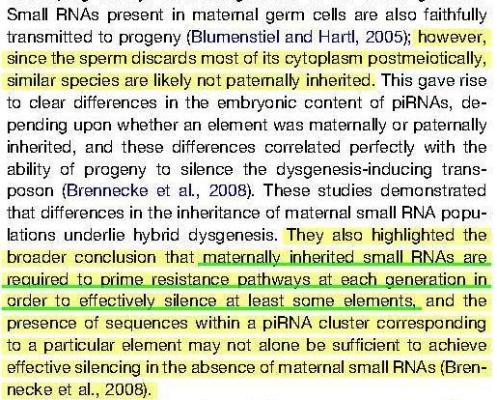
656 Cell 136,656–668,February20,2009 ª2009ElsevierInc.

Slide 17
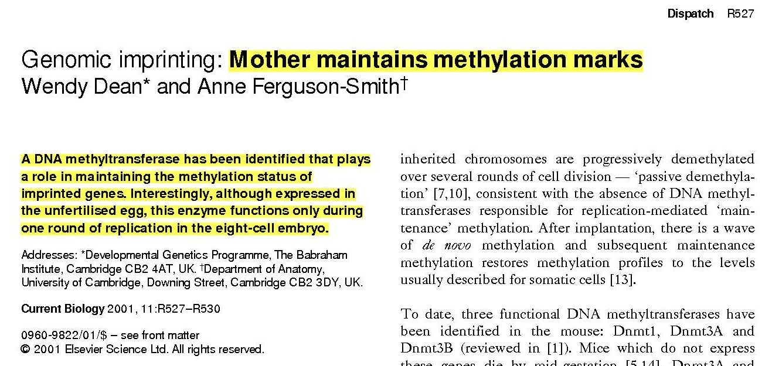

Slide 18
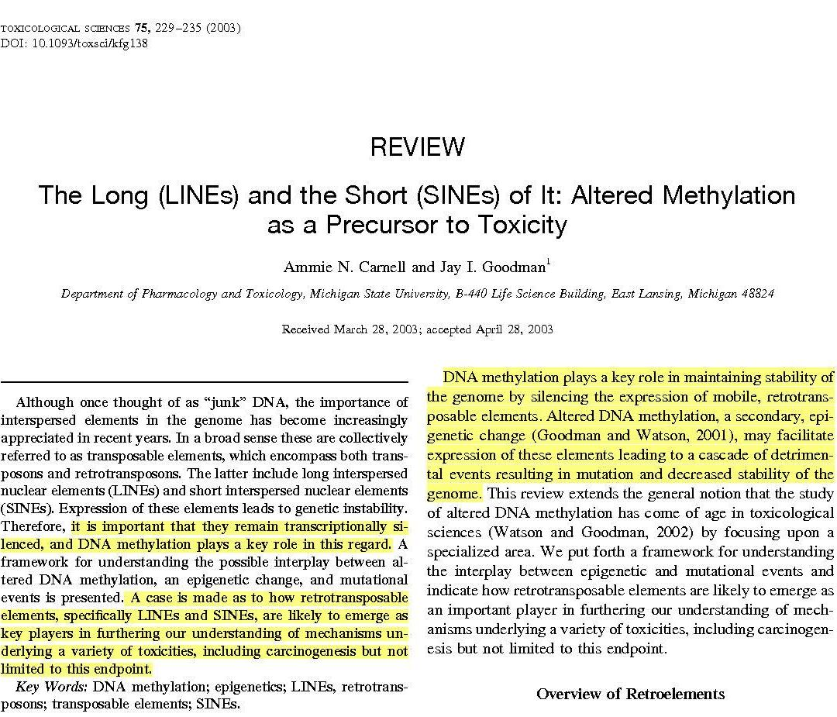

Slide 19
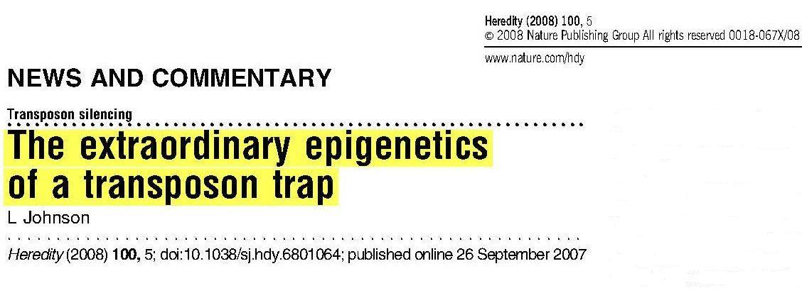
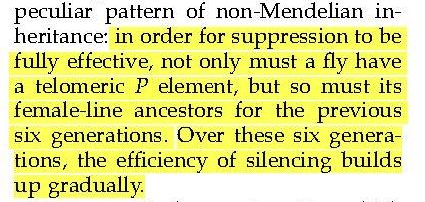

Slide 20
“Enmity between thy seed and her seed”:
Hypothesis:
The microRNA’s and DNA methylation are what God put in place after Adam and Eve sinned to keep them from dying within hours of ingesting the fruit. These defense (plus undoubtedly others not discovered) mechanisms were implemented to counteract the lethal inoculation of TE’s.

Slide 21
Since the Adversary is the “father of lies”, he cannot be trusted to tell us the consequences of embracing his version of reality or God’s.
Therefore, only God can be trusted to reveal not only the true status of both “kingdoms”, but also to define the etiology and physical basis of the “second” death.

Slide 22
At this point, God has temporarily “suspended” the cause and affect relationship of sin and death (Second Death to be defined later). Having done this, He still must clearly demonstrate or “explain” this death to the universe so that not only it’s dimensions are exhibited for all to see, but also it’s cause is fully unmasked.

Slide 23
Christ took upon Himself human nature so that:
He could formulate a “cure” for the TE “disease”.
Demonstrate the “second” death.
Reveal the Father to us.

Slide 24
But when the fullness of the time was come, God sent forth his Son, made of a woman, made under the law, To redeem them that were under the law, that we might receive the adoption of sons. Galatians 4:4,5 KJV

Slide 25
God/Heaven provided 23 chromosomes Mary provided 23 chromosomes
Hebrews 10:5 Why when he comes into the world, he said, Sacrifice and offering you would not, but a body have you prepared me: AKJV
Hebrews 2:16 For truly he took not on him the nature of angels; but he took on him the seed of Abraham. AKJV
Romans 1:3 Concerning his Son Jesus Christ our Lord, which was made of the seed of David according to the flesh; AKJV

Slide 26
Who was Christ’s father?
While he yet spoke, behold, a bright cloud overshadowed them: and behold a voice out of the cloud, which said, This is my beloved Son, in whom I am well pleased; hear you him. Matthew 17:5 AKJV
These words spoke Jesus, and lifted up his eyes to heaven, and said, Father, the hour is come; glorify your Son, that your Son also may glorify you: John 17: 1 AKJV

Slide 27
Who was His mother?
And the angel answered and said to her, The Holy Ghost shall come on you, and the power of the Highest shall overshadow you: therefore also that holy thing which shall be born of you shall be called the Son of God. Luke 1:35 AKJV
(As it is written in the law of the Lord, Every male that openeth the womb shall be called holy to the Lord;)
Luke 2:23 KJV

Slide 28
Matthew’s account of Christ’s genealogy in Ch. 1 is accepted as chronicling Joseph’s lineage. Since Matthew was written primarily to the Jews, he was trying to show that Christ was “born” into the lineage of King David, thus fulfilling scripture. Matthew 1: 18-19 clearly indicates that Matthew knew that Joseph had no paternity in relationship to Christ.
The lineage in Luke 3 is accepted as being Mary’s ancestors as it differs from Matthew’s account. The question then is: Why place Mary’s genealogy in Luke if none of her DNA was in Christ? There was no cultural reason to do so.

Slide 29
To say that all 46 chromosomes came from heaven to make a “second” Adam, which were “artificially inseminated” into Mary making her a “surrogate mother” will not work for the following reasons:
Christ would have to look just like Adam (10+ feet tall, perfect build, around 800 to 1000 pounds, remarkably handsome).
TE’s have caused a very large number of genes to be partially or completely deleted. Thus Christ would have capabilities that the rest of humanity (excluding Adam and Eve) have never had, which would clearly have set him apart from everyone living at the time. He would have stood out as being peculiar to say the least.
TE’s influence the placement of receptors for neurotransmitters in the brain (e.g. voles), and significantly alter behavior and brain function.

Slide 30
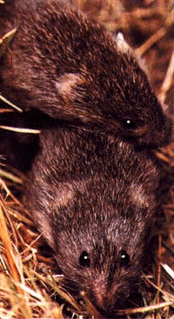
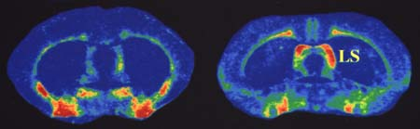
The loves of voles
Vasopressin receptors in the brain
Prairie vole
Montane vole
Married bliss
in prairie voles
Insel, T. and Young, L. 2001. Nature reviews Neuroscience 2:129-136

Slide 31
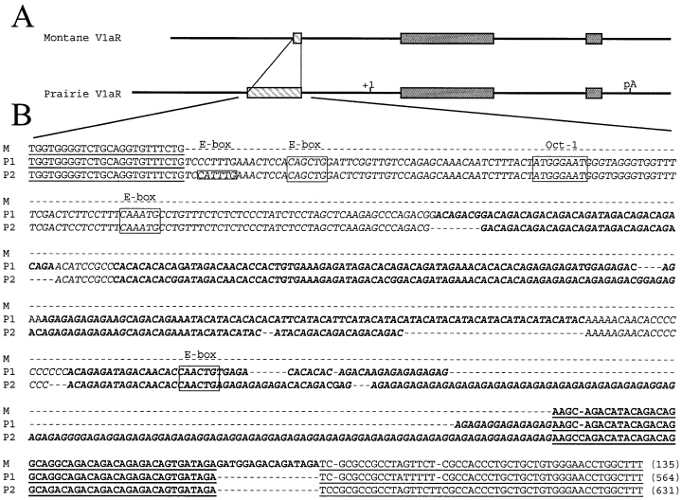
AVPR1A
Hammock & Young 2002. European Journal of Neuroscience 16:399-402.

Slide 32
For he shall grow up before him as a tender plant, and as a root out of a dry ground: he has no form nor comeliness; and when we shall see him, there is no beauty that we should desire him. He is despised and rejected of men; a man of sorrows, and acquainted with grief: and we hid as it were our faces from him; he was despised, and we esteemed him not. Isaiah 53:2-3 AKJV
chŏlîy
BDB Definition:
1) sickness
Part of Speech: noun masculine

Slide 33
Isaiah 53:3 He is despised and abandoned of men, a Man of pains, and acquainted with sickness. And as it were hiding our faces from Him, He being despised, and we did not value Him. LITV Isaiah 53:4 Surely He has borne our sicknesses, and He carried our pain; yet we esteemed Him plagued, smitten by God, and afflicted. LITV
To date, all of the investigated disease processes have shown a TE etiology, consequently for Christ to have “borne our sickness”, His genome would have had to include them.

Slide 34
Christ took on humanity’s “hijacked” nature through his mother. TE’s have conclusively been shown to permeate any genome to which they are exposed. Whether the TE’s in Mary’s 23 chromosomes “jumped” and infected Christ’s 23 heavenly chromosomes we are not told.
Hebrews 2:14 For as much then as the children are partakers of flesh and blood, he also himself likewise took part of the same; that through death he might destroy him that had the power of death, that is, the devil; AKJV

Slide 35
Mat 8:17 That it might be fulfilled which was spoken by Esaias the prophet, saying, Himself took our infirmities, and bare our sicknesses.
Hebrews 2:17 Why in all things it behooved him to be made like to his brothers, that he might be a merciful and faithful high priest in things pertaining to God, to make reconciliation for the sins of the people. AKJV

Slide 36
Hebrews 2:18 For in that he himself has suffered being tempted, he is able to succor them that are tempted. AKJV
How could Christ experience temptation as all of us have, if His mind was fundamentally different from ours in the placement of receptors for different neurotransmitters (e.g. testosterone)?

Slide 37
Christ took upon Himself human nature so that:
He could formulate a “cure” for the TE “disease”.
Demonstrate the “second” death.
Reveal the Godhead to humanity.

Slide 38
CURE
Hebrews 2:17 Why in all things it behooved him to be made like to his brothers, that he might be a merciful and faithful high priest in things pertaining to God, to make reconciliation for the sins of the people. AKJV
Hebrews 2:18 For in that he himself has suffered being tempted, he is able to succor them that are tempted. AKJV
Hebrews 4:15 For we have not an high priest which cannot be touched with the feeling of our infirmities; but was in all points tempted like as we are, yet without sin. AKJV
John 17:19 And for their sakes I sanctify myself, that they also might be sanctified through the truth. AKJV

Slide 39
Hebrews 5:9 And being made perfect, he became the author of eternal salvation to all them that obey him; AKJV
τελειόω
teleioō
tel-i-o'-o
From G5046; to complete, that is, (literally) accomplish, or (figuratively) consummate (in character): - consecrate, finish, fulfill, (make) perfect.

Slide 40
Mat 5:48 Be ye therefore perfect, even as your Father which is in heaven is perfect.
John 14:30 Hereafter I will not talk much with you: for the prince of this world cometh, and hath nothing in me.
James 1:13 Let no man say when he is tempted, I am tempted of God: for God cannot be tempted with evil, neither tempteth he any man:

Slide 41
Christ took upon Himself our “human nature” (TE’s) in order to perfect a way to completely “silence” them. This acquired, first-hand knowledge enables Him to become the “author of eternal salvation” for all humanity.
Isaiah 53:11 He shall see of the travail of his soul, and shall be satisfied: by his knowledge shall my righteous servant justify many; for he shall bear their iniquities. AKJV
Hebrews 1:3 Who being the brightness of his glory, and the express image of his person, and upholding all things by the word of his power, when he had by himself purged our sins, sat down on the right hand of the Majesty on high: AKJV

Slide 42
Hebrews 2:11 For both he that sanctifies and they who are sanctified are all of one: for which cause he is not ashamed to call them brothers, AKJV
Sanctifies = to purify
Hebrews 7:25 Why he is able also to save them to the uttermost that come to God by him, seeing he ever lives to make intercession for them. AKJV
Intercession (Greek root) = to hit the mark
Sin (Hebrew) = to miss a mark

Slide 43
Definition of Grace
Titus 3:5-7 …... It was not because of any good deeds that we ourselves had done, but because of his own mercy that he saved us, through the Holy Spirit, who gives us new birth and new life by washing us. God poured out the Holy Spirit abundantly on us through Jesus Christ our Savior, so that by his grace we might be put right with God and come into possession of the eternal life we hope for. GNB

Slide 44
Mark 2:4 Because of the crowd, however, they could not get the man to him. So they made a hole in the roof right above the place where Jesus was. When they had made an opening, they let the man down, lying on his mat.
Mark 2:5 Seeing how much faith they had, Jesus said to the paralyzed man, "My son, your sins are forgiven."
Mark 2:6 Some teachers of the Law who were sitting there thought to themselves,
Mar 2:7 "How does he dare talk like this? This is blasphemy! God is the only one who can forgive sins!"
Mark 2:8 At once Jesus knew what they were thinking, so he said to them, "Why do you think such things?
Mark 2:9 Is it easier to say to this paralyzed man, 'Your sins are forgiven,' or to say, 'Get up, pick up your mat, and walk'? GNB

Slide 45
Heal = Save
Heal me, O LORD, and I shall be healed; save me, and I shall be saved: for thou art my praise.
Jer. 17:14 AKJV

Slide 46
John 3:5 Jesus answered, Truly, truly, I say to you, Except a man be born of water and of the Spirit, he cannot enter into the kingdom of God. John 3:6 That which is born of the flesh is flesh; and that which is born of the Spirit is spirit.
John 3:7 Marvel not that I said to you, You must be born again.
John 3:8 The wind blows where it wants, and you hear the sound thereof, but can not tell from where it comes, and where it goes: so is every one that is born of the Spirit. AKJV

Slide 47
After three years unraveling the mysteries of TE’s, Christ successfully formulated a complete “cure”.
John 14:30 Hereafter I will not talk much with you: for the prince of this world comes, and has nothing in me. AKJV
John17:4 I have glorified you on the earth: I have finished the work which you gave me to do. AKJV
1John 3:8 Whoever continues to sin belongs to the Devil, because the Devil has sinned from the very beginning. The Son of God appeared for this very reason, to destroy what the Devil had done. GNB

Slide 48
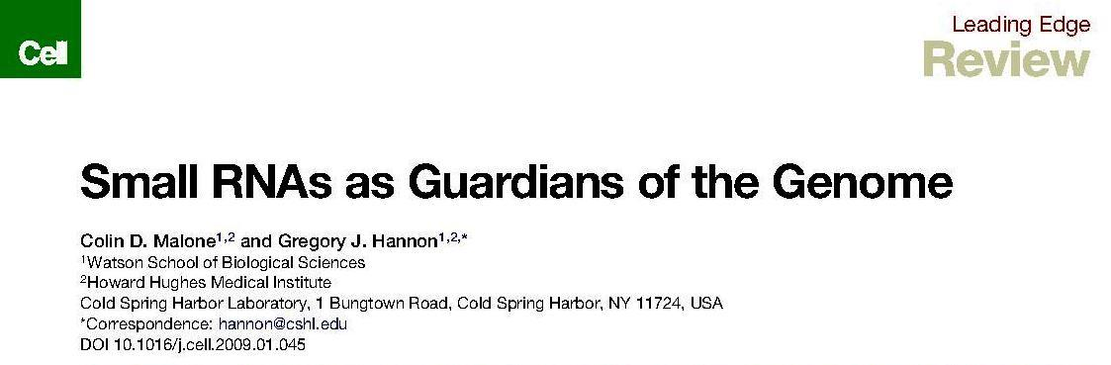
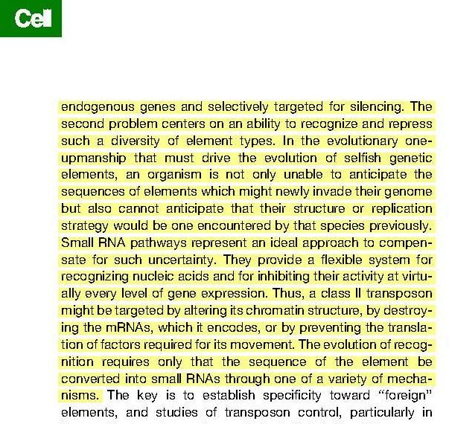
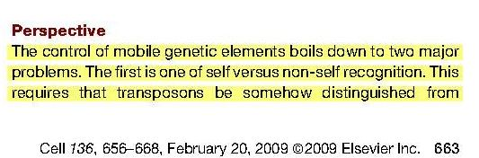
If Christ developed an answer to the TE problem we should see something in our genome dynamics which would support this hypothesis:

Slide 49
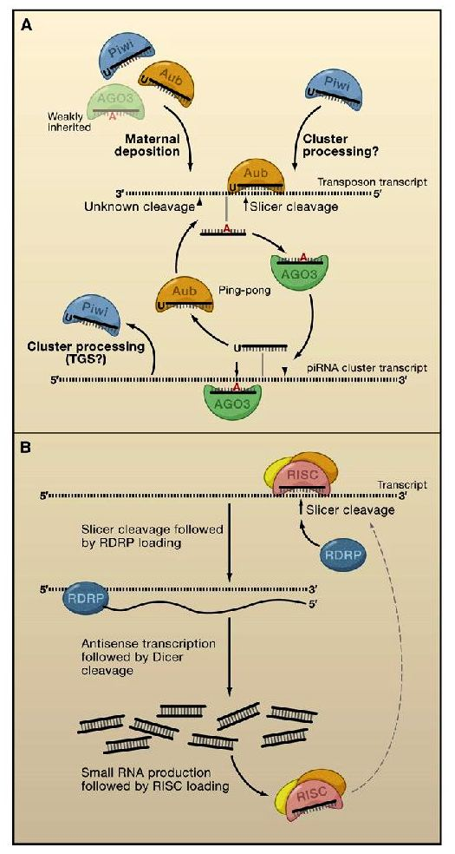
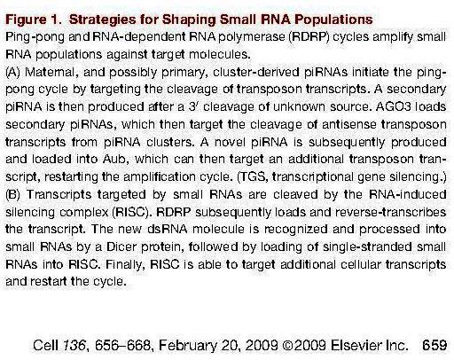

Slide 50
John 15:1-6
(1) "I am the real vine, and my Father is the gardener.
(2) He breaks off every branch in me that does not bear fruit, and he prunes every branch that does bear fruit, so that it will be clean and bear more fruit.
(3) You have been made clean already by the teaching I have given you.
(4) Remain united to me, and I will remain united to you. A branch cannot bear fruit by itself; it can do so only if it remains in the vine. In the same way you cannot bear fruit unless you remain in me.
(5) "I am the vine, and you are the branches. Those who remain in me, and I in them, will bear much fruit; for you can do nothing without me.
(6) Those who do not remain in me are thrown out like a branch and dry up; such branches are gathered up and thrown into the fire, where they are burned. GNB

Slide 51
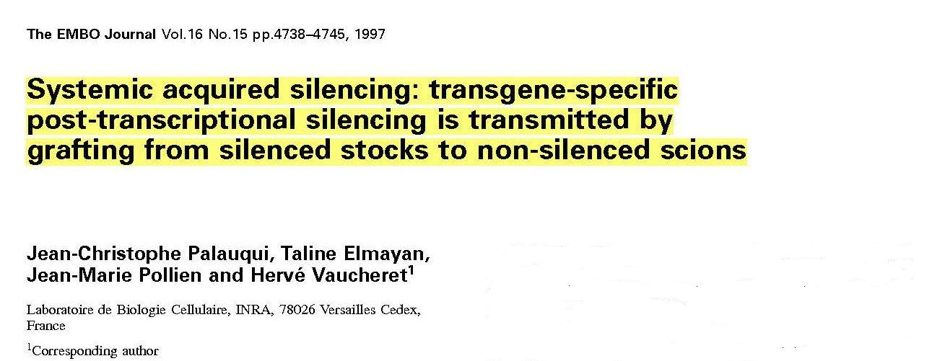
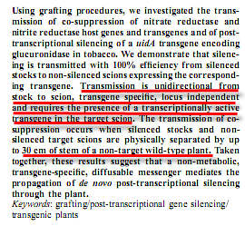

Slide 52
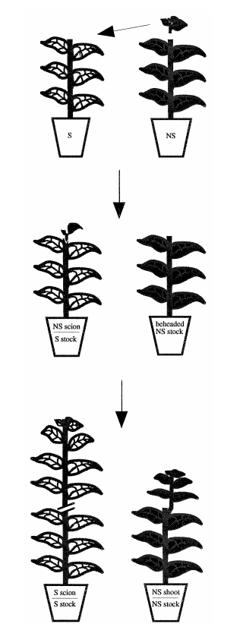
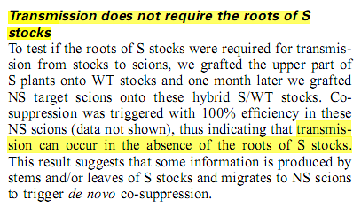
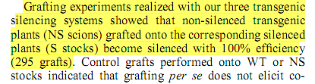
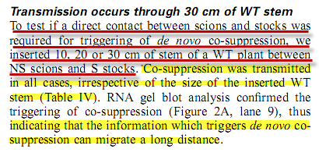
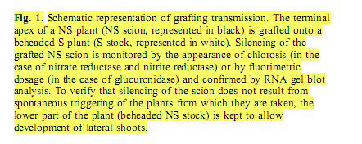

Slide 53
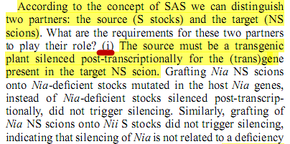
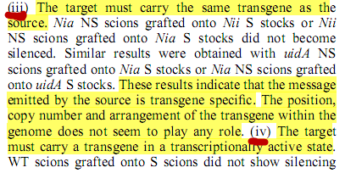
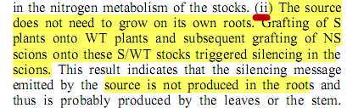
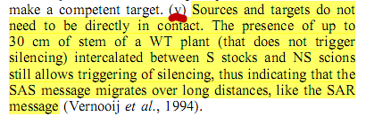

Slide 54
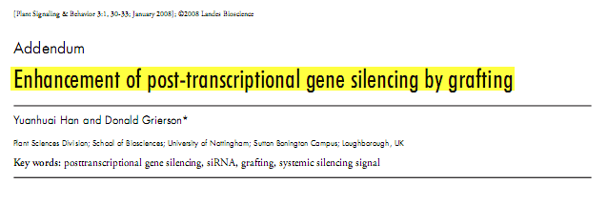
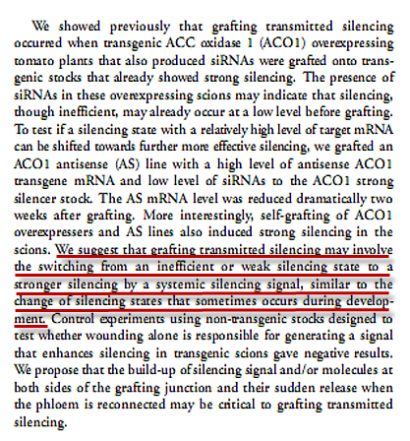

Slide 55
"The Helper will come---the Spirit, who reveals the truth about God and who comes from the Father. I will send him to you from the Father, and he will speak about me. John 15:26 GNB

Slide 56
Behold, the days come, said the LORD, that I will make a new covenant with the house of Israel, and with the house of Judah: Not according to the covenant that I made with their fathers in the day that I took them by the hand to bring them out of the land of Egypt; which my covenant they broke, although I was an husband to them, said the LORD: But this shall be the covenant that I will make with the house of Israel; After those days, said the LORD, I will put my law in their inward parts, and write it in their hearts; and will be their God, and they shall be my people.
Jeremiah 31: 31-33 AKJV

Slide 57
What is the result of placing a “new heart” in us?
1John 3:8 Whoever continues to sin belongs to the Devil, because the Devil has sinned from the very beginning. The Son of God appeared for this very reason, to destroy what the Devil had done. GNB
So get rid of your old self, which made you live as you used to---the old self that was being destroyed by its deceitful desires. Your hearts and minds must be made completely new, and you must put on the new self, which is created in God's likeness and reveals itself in the true life that is upright and holy. Ephesians 4; 22-24 GNB

Slide 58
What happens when He makes us “new”?
1Peter 1:23 Being born again, not of corruptible seed, but of incorruptible, by the word of God, which lives and stays for ever. AKJV
John 5:18 We know that whoever is born of God sins not; but he that is begotten of God keeps himself, and that wicked one touches him not. AKJV
1John 3:9 Whoever is born of God does not commit sin; for his seed remains in him: and he cannot sin, because he is born of God. AKJV
2Co 5:17 Therefore, if anyone is in Christ, he is a new creation; the old things passed away; behold, all things have become new. EMTV

Slide 59
But what about addictions?
John 8:34 Jesus said to them, “I am telling you the truth: everyone who sins is a slave of sin.” GNB
John 8:32 you will know the truth, and the truth will set you free. GNB
Romans 5:20 Law was introduced in order to increase wrongdoing; but where sin increased, God's grace increased much more. GNB

Slide 60
Romans 8:1 There is no condemnation now for those who live in union with Christ Jesus.
Romans 8:2 For the law of the Spirit, which brings us life in union with Christ Jesus, has set me free from the law of sin and death.
Romans 8:3 What the Law could not do, because human nature was weak, God did. He condemned sin in human nature by sending his own Son, who came with a nature like our sinful nature, to do away with sin.
Romans 8:4 God did this so that the righteous demands of the Law might be fully satisfied in us who live according to the Spirit, and not according to human nature. GNB

Slide 61
When do we get a new “heart”?
Matthew 5:48 Be you therefore perfect (complete), even as your Father which is in heaven is perfect (complete). AKJV
Titus 2:12 Teaching us that, denying ungodliness and worldly lusts, we should live soberly, righteously, and godly, in this present world; AKJV
Philippians 2:15 so that you may be innocent and pure as God's perfect children, who live in a world of corrupt and sinful people. You must shine among them like stars lighting up the sky, GNB

Slide 62
Salvation Hypothesis
If we follow TE facilitated inclinations we;
1) Unmethylate silenced TE.s
2)Additional TE insertions in “hotspots”
If we follow the Spirits leading;
1) More TEs are silenced (Methylated or Mutated)
2) TEs excised and/or destroyed

Slide 63
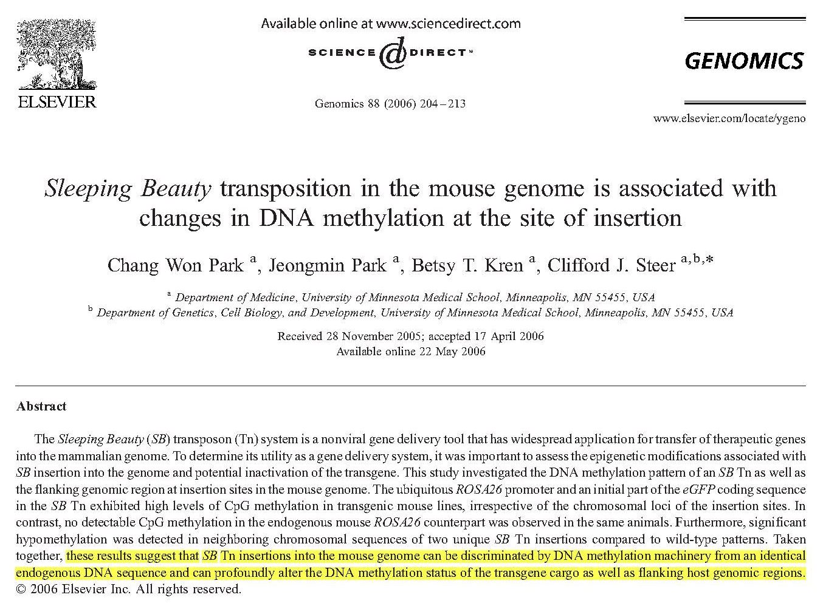

Slide 64
Christ must individually craft a “cure” for each one of us due to the characteristics of the TE “disease”.
Acts 4:12 Neither is there salvation in any other: for there is none other name under heaven given among men, whereby we must be saved. AKJV
John 1:12 But as many as received him, to them gave he power to become the sons of God, even to them that believe on his name.
Eph 1:19,20 ….and how very great is his power at work in us who believe. This power working in us is the same as the mighty strength which he used when he raised Christ from death and seated him at his right side in the heavenly world.
GNB

Slide 65
The Bible says that we are "cleansed by His blood". Doesn’t that mean His death on the cross?
Christ’s blood = Christ’s life
Leviticus 17:11 The life of every living thing is in the blood, and that is why the LORD has commanded that all blood be poured out on the altar to take away the people's sins. Blood, which is life, takes away sins. GNB
Leviticus 17:14 The life of every living thing is in the blood, and that is why the LORD has told the people of Israel that they shall not eat any meat with blood still in it and that anyone who does so will no longer be considered one of his people. GNB
Romans 5:10 We were God's enemies, but he made us his friends through the death of his Son. Now that we are God's friends, how much more will we be saved by Christ's life! GNB

Slide 66
I Corinthians 6:11 And such were some of you: but you are washed, but you are sanctified, but you are justified in the name of the Lord Jesus, and by the Spirit of our God.
AKJV

Slide 67
The Science of Redemption.--The scheme of redemption far exceeds the comprehension of the human mind. The great condescension on the part of God is a mystery that is beyond our fathoming. The greatness of the plan cannot be fully comprehended, nor could infinite Wisdom devise a plan that would surpass it. It could only be successful by the clothing of divinity with humanity, by Christ becoming man, and suffering the wrath which sin has made because of the transgression of God's law. Through this plan the great, the dreadful God can be just, and yet be the justifier of all who believe in Jesus, and who receive Him as their personal Saviour. This is the heavenly science of redemption, of saving men from eternal ruin, and can be carried out only through the incarnation of the Son of God in humanity, through His triumph over sin and death, and in seeking to fathom this plan all finite intelligences are baffled (Letter 43, 1895).

Slide 68
Christ took upon Himself human nature so that:
He could formulate a “cure” for the TE “disease”.
Demonstrate the “second” death.

Slide 69
What does the Bible say about the “second” death?
Romans 6:23 For the wages of sin is death; but the gift of God is eternal life through Jesus Christ our Lord. AKJV
Romans 6:23 For sin pays its wage---death; but God's free gift is eternal life in union with Christ Jesus our Lord. GNB

Slide 70
DEFINITIONS
GOD’S CHARACTER
GODS LAW
“ And the LORD passed by before him, and proclaimed, The LORD, The LORD God, merciful and gracious, long-suffering, and abundant in goodness and truth, Keeping mercy for thousands, forgiving iniquity and transgression and sin, and that will by no means clear the guilty….. ..” Exodus 34:6-7 AKJV
The incredibly complex way (e.g. laws of chemistry, biology, physics etc., and the “blueprint” upon which they are assimilated) wherein God has made His creation to function.

Slide 71
GOD’S “LAW” IS A DIRECT EXPRESSION OF HIS CHARACTER
SIN
TEN COMMANDMENTS
Any activity (mental or behavioral) which is outside of God’s Law….or put another way; “Any activity that is TE facilitated.”
Ten broad categories wherein TE’s have “programmed” a propensity to function outside of God’s Law.

Slide 72
Let’s go back to the beginning to again redefine exactly what was disputed in the Garden.
GOD SAID:
Genesis 2:16 And the LORD God commanded the man, saying, Of every tree of the garden you may freely eat: AKJV
Genesis 2:17 But of the tree of the knowledge of good and evil, you shall not eat of it: for in the day that you eat thereof you shall surely die. AKJV
THE ADVERSARY SAID:
Genesis 3:4 And the serpent said to the woman, You shall not surely die:
Genesis 3:5 For God does know that in the day you eat thereof, then your eyes shall be opened, and you shall be as gods, knowing good and evil.

Slide 73
As we discussed in previous lectures, there are two “deaths”:
FIRST DEATH: All humanity (except Enoch and Elijah) experience this death. It is not permanent…all will be brought back to life again.
John 5:28 Marvel not at this: for the hour is coming, in which all that are in the graves shall hear his voice,
John 5:29 And shall come forth; they that have done good, to the resurrection of life; and they that have done evil, to the resurrection of damnation. AKJV

Slide 74
SECOND DEATH: Those who are not “healed” from the “disease” of sin will experience this death. There is no resurrection from this death.
Revelation 20:14 And death and hell were cast into the lake of fire. This is the second death. AKJV
Revelation 20:15 And whoever was not found written in the book of life was cast into the lake of fire. AKJV
Revelation 20:6 Blessed and holy is he that has part in the first resurrection: on such the second death has no power, but they shall be priests of God and of Christ, and shall reign with him a thousand years. AKJV

Slide 75
Since Adam and Eve “fell”, both the universe and every human has seen or experienced the “first” death.
But what about the “second” death?
Why is this death final?
Is God in any way involved with this death?
Do we have any record of any one experiencing this death?

Slide 76
2Corinthians 5:21 For he has made him to be sin for us, who knew no sin; that we might be made the righteousness of God in him. AKJV
Christ will come and die the second death in its entirety….the first, and only, being to do so.

Slide 77
Garden of Gethsemane
Luke 22:41 And he was withdrawn from them about a stone's cast, and kneeled down, and prayed,
Luke 22:42 Saying, Father, if you be willing, remove this cup from me: nevertheless not my will, but yours, be done.
Luke 22:44 And being in an agony he prayed more earnestly: and his sweat was as it were great drops of blood falling down to the ground. AKJV

Slide 78
Isaiah 52:14 Many people were shocked when they saw him; he was so disfigured that he hardly looked human.
Isaiah 52:15 But now many nations will marvel at him, and kings will be speechless with amazement. They will see and understand something they had never known.“
Isaiah 53:1 The people reply, "Who would have believed what we now report? Who could have seen the LORD's hand in this? GNB

Slide 79
Luke 22:43 And there appeared an angel to him from heaven, strengthening him. AKJV
The descriptions the Bible just gave us are God withdrawing from Christ and in so doing, “unlocking’” the TE’s that had been suppressed since the Garden of Eden.
Matthew 27:46 And about the ninth hour Jesus cried with a loud voice, saying, Eli, Eli, lama sabachthani? that is to say, My God, my God, why have you forsaken me? AKJV

Slide 80
How does sin cause the “second” death?
SIN: Any activity (mental or behavioral) which is outside of God’s Law….or put another way: Any activity that is TE facilitated.
Hypothesis: There are two ways in which sin causes irrevocable death.
1. Demethylation: A substantial portion (30% -40%) of the TE’s are “methylated” or “locked-up” and rendered non-functional. The “unlocking” of these TE’s causes death of the organism. (Already covered earlier)
2. Unstable Genome: The large amount of “added” genetic material (TE’s) greatly weaken the genome to the point that strong outside energy fields cause it, and the “altered” proteins it codes for, to disintegrate.

Slide 81
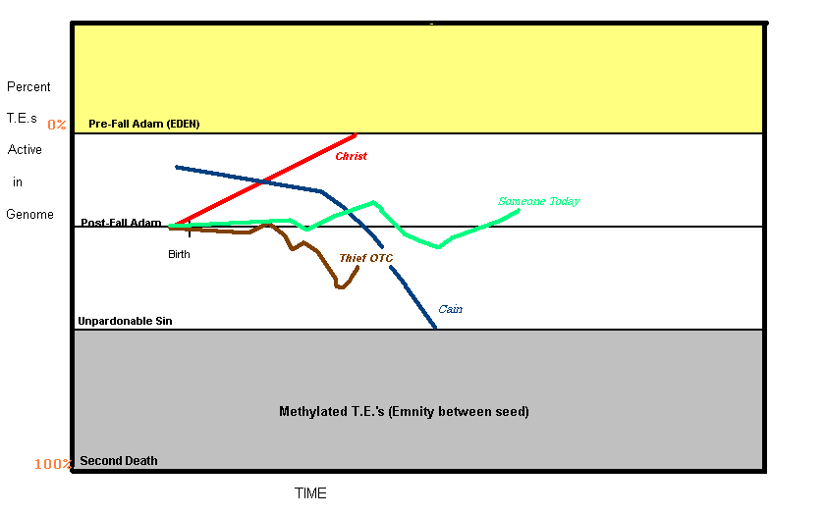

Slide 82
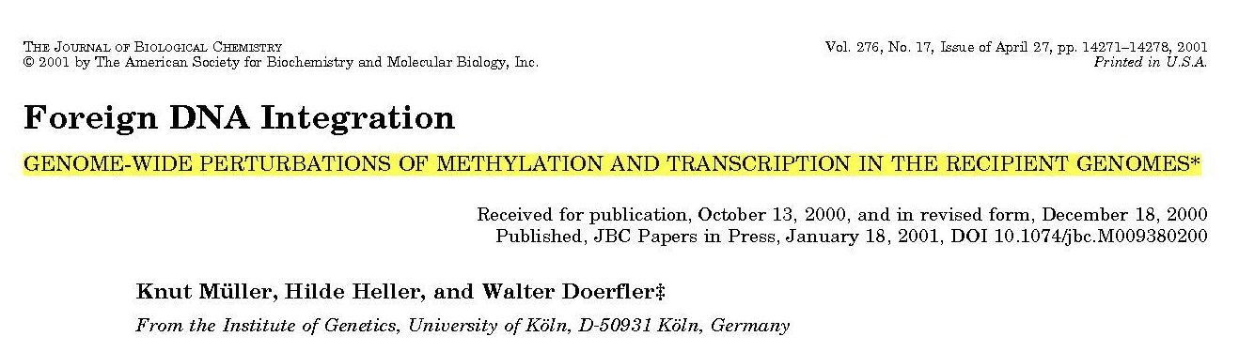
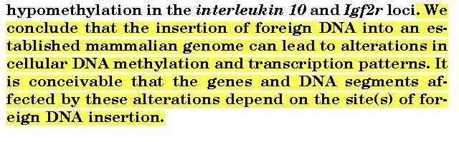
James 2:10 Whoever breaks one commandment is guilty of breaking them all. GNB

Slide 83
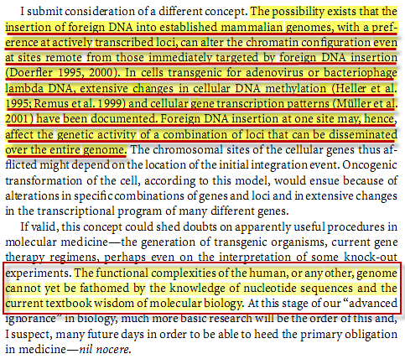
DNA Methylation Basic Mechanisms, W. Doerfler & P. Bohm. Springer 2006. p.10

Slide 84
Luke 23:44 And it was about the sixth hour, and there was a darkness over all the earth until the ninth hour.
Luke 23:45 And the sun was darkened, and the veil of the temple was rent in the middle.
Luke 23:46 And when Jesus had cried with a loud voice, he said, Father, into your hands I commend my spirit: and having said thus, he gave up the ghost. AKJV

Slide 85
John 19:33 But when they came to Jesus, and saw that he was dead already, they broke not his legs:
John 19:34 But one of the soldiers with a spear pierced his side, and immediately came there out blood and water. AKJV

Slide 86
1Peter 2:24 Who his own self bore our sins in his own body on the tree, that we, being dead to sins, should live to righteousness: by whose stripes you were healed. AKJV
1Peter 3:18 For Christ also has once suffered for sins, the just for the unjust, that he might bring us to God, being put to death in the flesh, but quickened by the Spirit: AKJV
Hebrews 2:14 For as much then as the children are partakers of flesh and blood, he also himself likewise took part of the same; that through death he might destroy him that had the power of death, that is, the devil; AKJV
Romans 5:10 We were God's enemies, but he made us his friends through the death of his Son. Now that we are God's friends, how much more will we be saved by Christ's life! GNB

Slide 87
Christ’s demonstration of the “second” death was not just for us, but for the whole on-looking universe. In this way, God proved that the breaking of His Law resulted in a “cause-and-effect” death. Consequently, the Adversary’s claims against Him were all proven to be false.
John 12:32 And I, if I be lifted up from the earth, will draw all (men) to me. AKJV
Colossians 1:19 For it was by God's own decision that the Son has in himself the full nature of God.
Colossians 1:20 Through the Son, then, God decided to bring the whole universe back to himself. God made peace through his Son's blood on the cross and so brought back to himself all things, both on earth and in heaven. GNB

Slide 88
We will now look closely at reason number two. Hypothesis: There are two ways in which sin causes irrevocable death.
Demethylation: A substantial portion (30% -40%) of the TE’s are “methylated” or “locked-up” and rendered non-functional. The “unlocking” of these TE’s causes death of the organism.
Unstable Genome: The large amount of “added” genetic material (TE’s) greatly weaken the genome to the point that strong outside energy fields cause it, and the “altered” proteins it codes for, to disintegrate.

Slide 89
In the Garden, Adam and Eve conversed daily with God. But now….. Hebrews 12:29 For our God is a consuming fire. AKJV
And he (Moses) said, I beseech you, show me your glory………
And he (God) said, You can not see my face: for there shall no man see me, and live.
And the LORD said, Behold, there is a place by me, and you shall stand on a rock:
And it shall come to pass, while my glory passes by, that I will put you in a cleft of the rock, and will cover you with my hand while I pass by:
And I will take away my hand, and you shall see my back parts: but my face shall not be seen. Exodus 33: 18-23

Slide 90
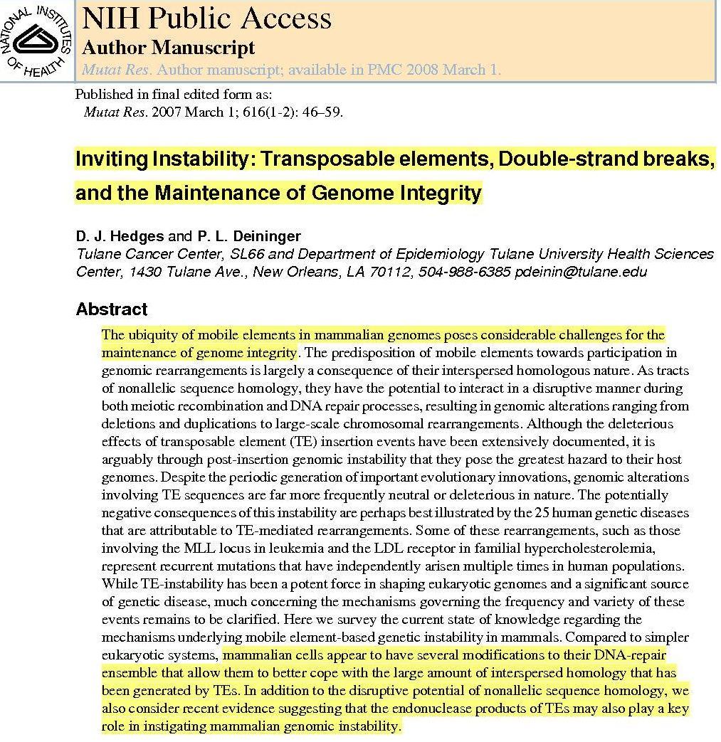

Slide 91
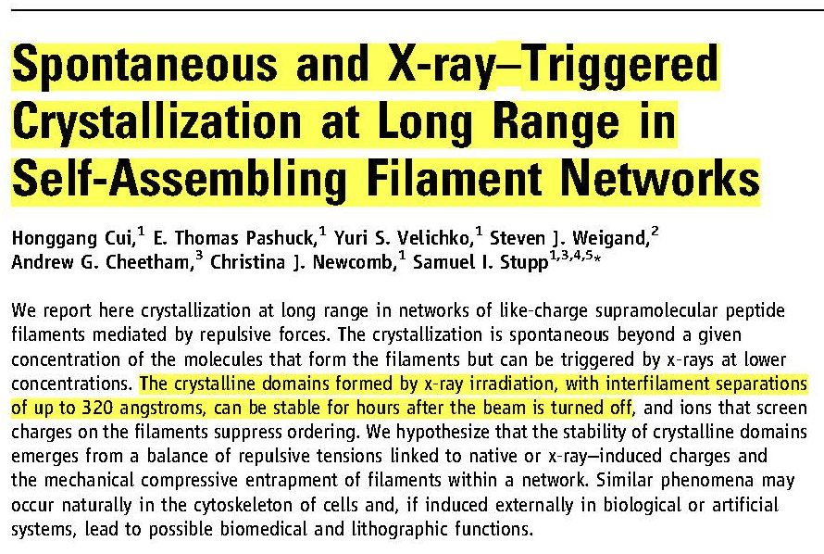
Science 327, 555 (2010)

Slide 92
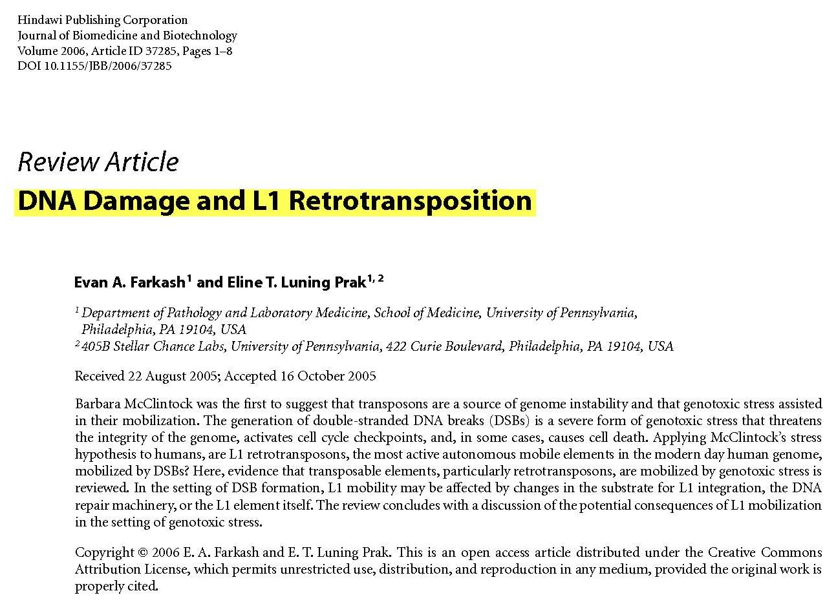
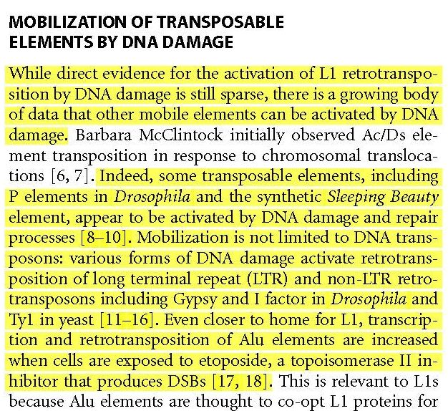
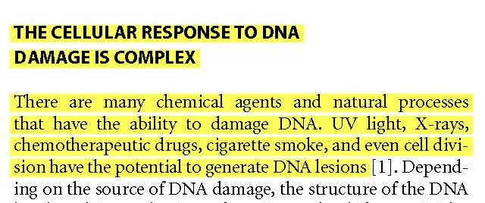
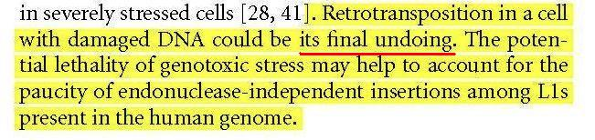

Slide 93
The LORD says to the nations, "Now I will act. I will show how powerful I am. You make worthless plans and everything you do is useless. My spirit is like a fire that will destroy you.
You will crumble like rocks burned to make lime, like thorns burned to ashes.
Let everyone near and far hear what I have done and acknowledge my power."
The sinful people of Zion are trembling with fright. They say, "God's judgment is like a fire that burns forever. Can any of us survive a fire like that?"
You can survive if you say and do what is right. Don't use your power to cheat the poor and don't accept bribes. Don't join with those who plan to commit murder or to do other evil things.
Then you will be safe; you will be as secure as if in a strong fortress. You will have food to eat and water to drink. Isaiah 33: 10-16 GNB

Slide 94
2Thessalonians 2:8 Then the Wicked One will be revealed, but when the Lord Jesus comes, he will kill him with the breath from his mouth and destroy him with his dazzling presence.
Zeph 1:2-3 The LORD said, "I am going to destroy everything on earth all human beings and animals, birds and fish. I will bring about the downfall of the wicked. I will destroy everyone, and no survivors will be left. I, the LORD, have spoken. GNB

Slide 95
Lake of Fire = God’s Glory
….. who only hath immortality, dwelling in light unapproachable; whom no man hath seen, nor can see: to whom be honor and power eternal. Amen.
1Tim. 6:16 ASV
Then death and the world of the dead were thrown into the lake of fire. (This lake of fire is the second death.)
Rev 20:14 GNB

Slide 96
The LORD Almighty says, "The day is coming when all proud and evil people will burn like straw. On that day they will burn up, and there will be nothing left of them. Malachi 4:1 GNB
So, as the fire devours the stubble, and the flame burns up the chaff; their root shall be like rottenness, and their blossoms shall go up like dust, because they have cast away the Law of Jehovah of Hosts, and despised the Word of the Holy One of Israel. Isaiah 5:24 MKJV

Slide 97
What will God’s glory do to those who have not had the Holy Spirit “deal” with the TE’s in their genome?
2Peter 3:7 But the heavens and the earth, which are now, by the same word are kept in store, reserved to fire against the day of judgment and perdition of ungodly men.
2Peter 3:10 But the day of the Lord will come as a thief in the night; in the which the heavens shall pass away with a great noise, and the elements shall melt with fervent heat, the earth also and the works that are therein shall be burned up. AKJV

Slide 98
When Christ rose from the tomb, how did God’s glory affect Him?
Matthew 28:2 And, behold, there was a great earthquake: for the angel of the Lord descended from heaven, and came and rolled back the stone from the door, and sat on it.
Matthew 28:3 His countenance was like lightning, and his raiment white as snow.
Matthew 28:4 And for fear of him the keepers did shake, and became as dead men. AKJV
"And, behold, there was a great earthquake: for the angel of the Lord descended from heaven." Clothed with the panoply of God, this angel left the heavenly courts. The bright beams of God's glory went before him, and illuminated his pathway. "His countenance was like lightning, and his raiment white as snow: and for fear of him the keepers did shake, and became as dead men." {DA 779.2}

Slide 99
After arising from the grave, Christ retained His human form, but took back His “God-ship”. The glory that was His before He came to earth was again invested in Him. If Christ had not perfectly corrected His genome, His human form would not have been able to withstand the power.
Christ came forth from the tomb glorified, and the Roman guard beheld Him. Their eyes were riveted upon the face of Him whom they had so recently mocked and derided. In this glorified Being they beheld the prisoner whom they had seen in the judgment hall, the one for whom they had plaited a crown of thorns. DA 779

Slide 100
Christ arose and His original glory flowed through His body. If He had not completely eradicated the TE problem, His body could not have withstood the “power of His glory”, when He took up His life again.
Now, since our message is that Christ has been raised from death, how can some of you say that the dead will not be raised to life?
If that is true, it means that Christ was not raised;
and if Christ has not been raised from death, then we have nothing to preach and you have nothing to believe…………………
And if Christ has not been raised, then your faith is a delusion and you are still lost in your sins. 1 Corinthians 15: 12-13, 16 AKJV

Slide 101
I Corinthians 15:20 But now is Christ risen from the dead, and become the firstfruits of them that slept. KJV

Slide 102
"Do not hold on to me," Jesus told her, "because I have not yet gone back up to the Father. But go to my brothers and tell them that I am returning to him who is my Father and their Father, my God and their God.“
John 20:17 GNB

Slide 103
SECOND DEATH SUMMARY:
In Christ’s death, one can see that the Adversary’s “new and better programming” really was a death sentence. If allowed to be fully expressed, Adam and Eve would have “dissolved” and died within hours of eating the fruit (“…dying thou shalt die”).
Furthermore, God’s glory (power that sustains His entire creation) would to them be a “consuming fire”. After the Adversary’s “programming” had had time to fully be implemented, God’s presence would have instantly vaporized them.

Slide 104
ULTIMATE PROOF BECAUSE:
John 10:18 No man takes it from me, but I lay it down of myself. I have power to lay it down, and I have power to take it again. This commandment have I received of my Father. AKJV

Slide 105
Hebrews 13:8 Jesus Christ the same yesterday, and to day, and for ever. AKJV
This is an incredibly important statement…..Christ not only found a way to silence and then remove the TE infestation, but was able to do it in such a way as to preserve the uniqueness of our personalities, memories and emotions. In other words, keep us intact without defect or loss. AMAZING!!!!

Slide 106
IN CONCLUSION
Romans 5:10 For if, when we were enemies, we were reconciled to God by the death of his Son, much more, being reconciled, we shall be saved by his life. AJKV

